Slide 1
A WEB ENGINEERING PROCESS
Chapter 3

Slide 2
Realities encountered in most WebApp projects
Requirements evolve over time
Changes will occur frequently
Time lines are short
Because of these realities, WebApps are often delivered incrementally

Slide 3
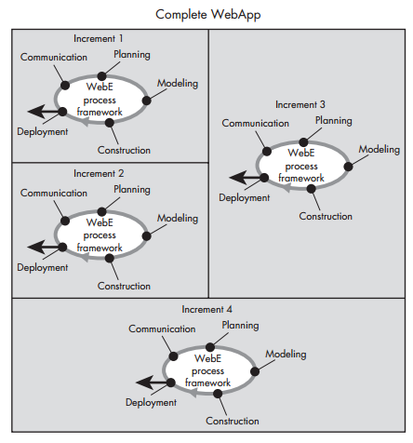
Example: A WebApp delivered in four increments

Slide 4
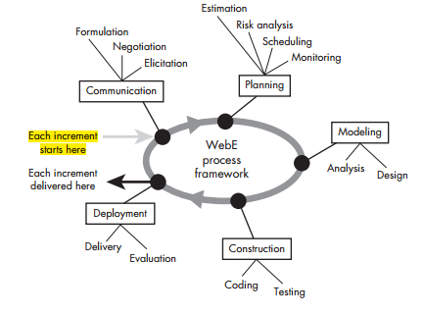
WebE Process Framework

Slide 5
How Is the Framework Refined?
In some cases, a framework activity is conducted informally.
In others, a distinct set of actions will be defined and conducted by team members.
Complex action may be further refined into a set of Web engineering tasks
Example: design
aesthetic design
content design
architecture design
navigation design and
component design

Slide 6
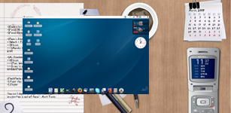
How Should the Communication Activity Be Refined?
Identify business stakeholders
Identify user categories
Formulate the business context
Define key business goals and objectives for the WebApp
Identify the problem
Define informational and applicative goals
Gather requirements
Develop usage scenarios

Slide 7
Planning : Tasks Required to Develop an Increment planning
communication activity provides you with a destination
Planning activity defines the route that you will take you toward the destination
Often defines the way points that will ensure that you’re heading in the right direction and making step-by-step progress
Also defines the resources that will be required to achieve each way point and estimates the time that will be required to get there

Slide 8
Planning: tasks and related questions
Refinement of the description of the WebApp increment to be delivered
Selection of the WebApp increment to be delivered now
Estimation of the effort and time required to deploy the increment.
Assessment of risks associated with the delivery of the increment
Define the development schedule for the increment
Establish of work products to be produced as a consequence of each framework activity
Define your approach to change control
Establish your quality assurance approach

Slide 9
Modeling
What Is Modeling?
Modeling is an activity that creates one or more conceptual representations of some aspect of the WebApp to be built.
conceptual representations
written documents,
sketches,
schematic diagrams,
graphical models,
written scenarios,
paper prototypes,
executable code
Modeling Actions
Analysis
Design

Slide 10
What Analysis Modelling Tasks
Decide whether a requirements model is needed.
Represent WebApp content.
Identify content relationships.
Refine and extend user scenarios.
Review usage scenarios
Create an interaction model for complex scenarios
Refine interface requirements.
Identify functions.
Define constraints and performance requirements.
Identify database requirements.

Slide 11
What Are the Elements of a Design Model
Interface design
Aesthetic design
Content design
Navigation design
Architecture design
Component design

